Slide 1
Azure Logic Apps(Auto-PL)
In this we are going to run pipeline automatically at a particular time by using Logic apps

Slide 2
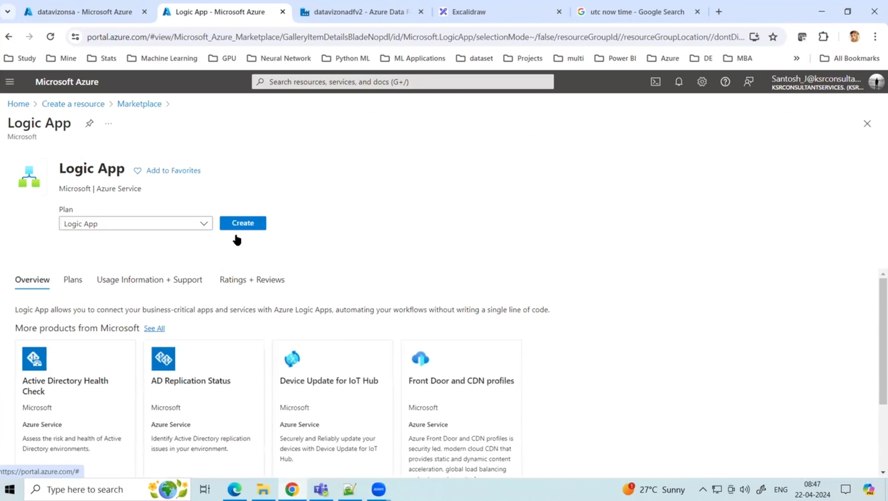
Create Azure Logic apps

Slide 3
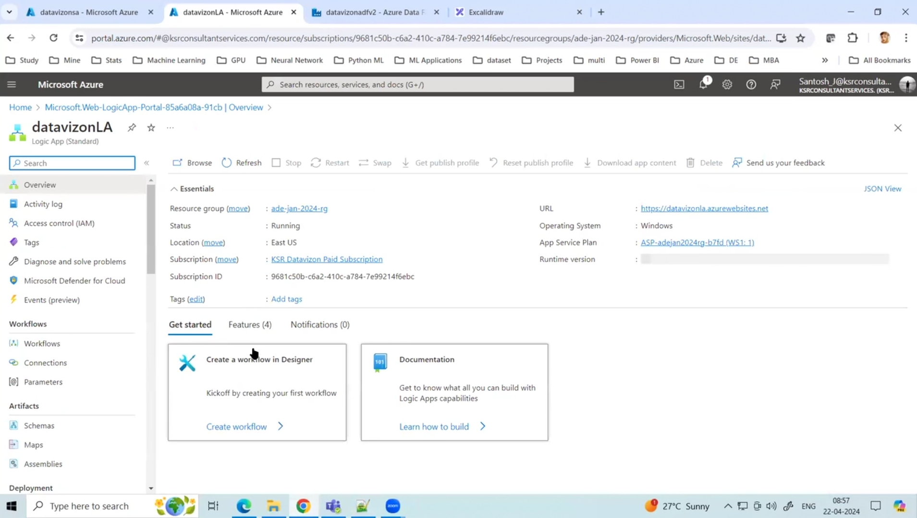
Create a New Workflow

Slide 4
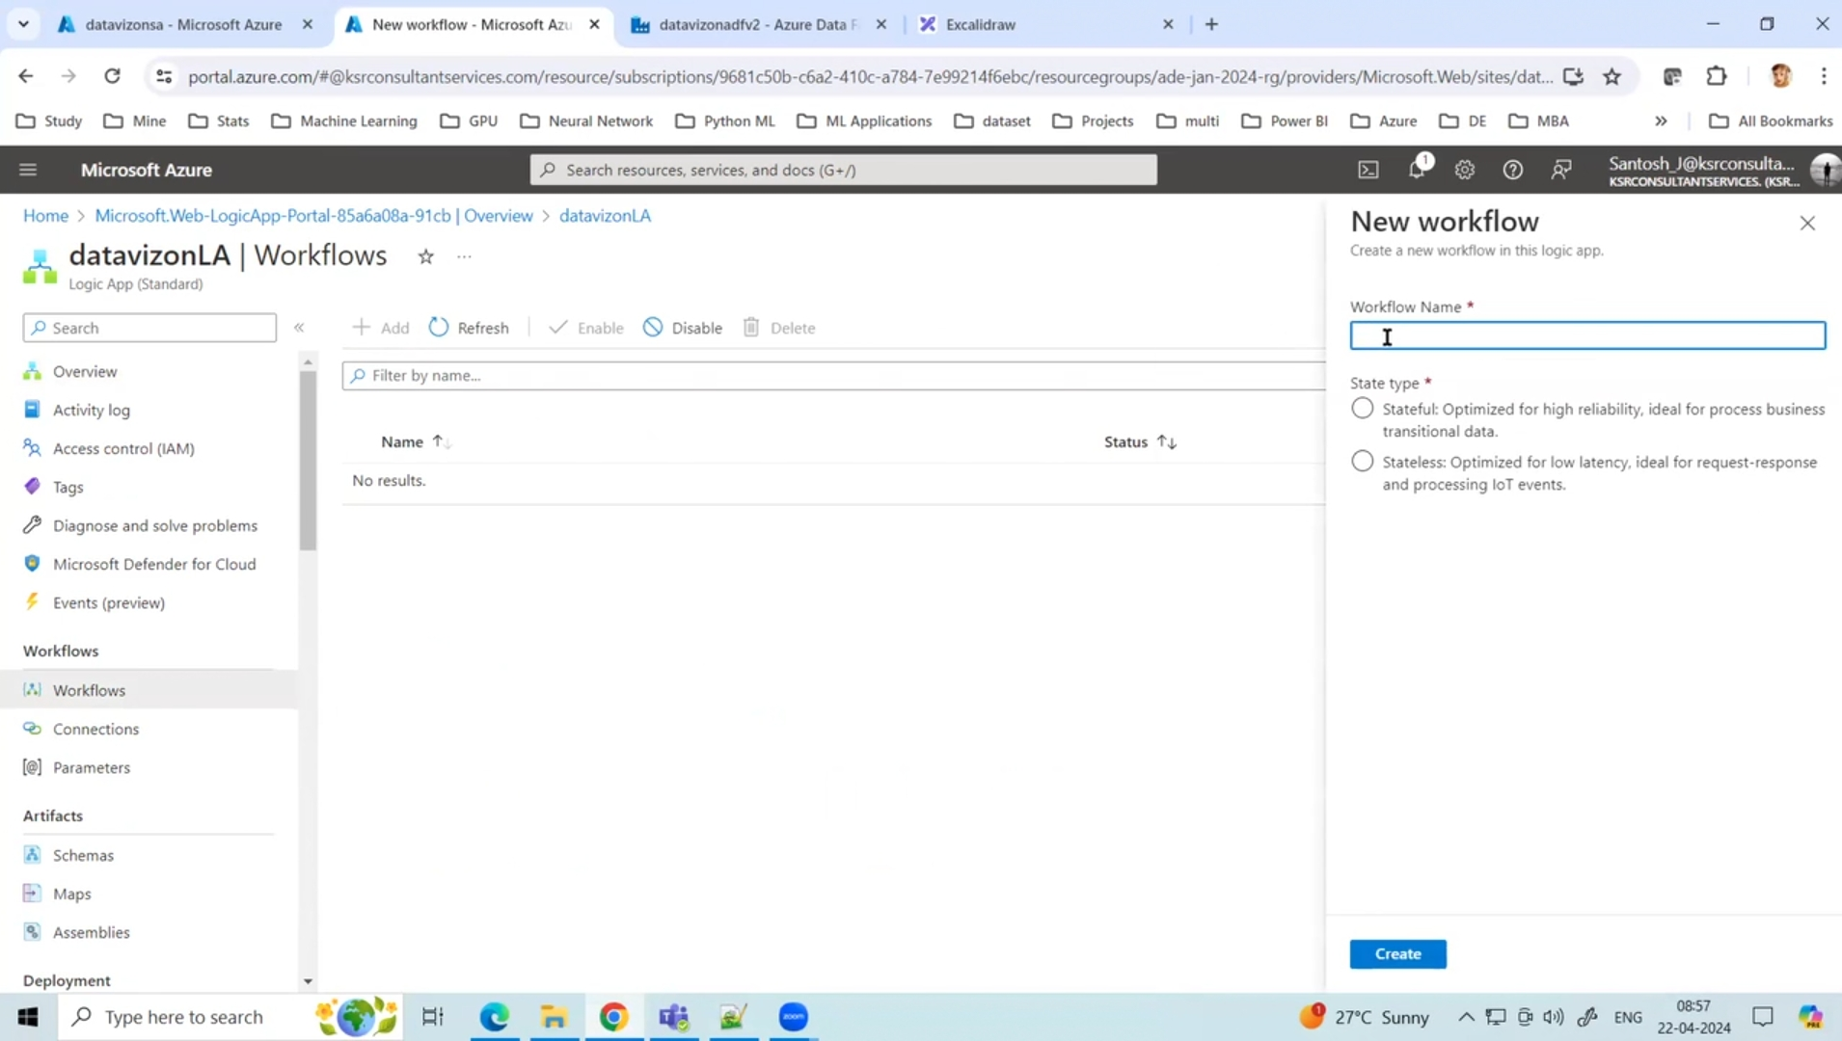
Add work flow and Give name to workflow > Create

Slide 5
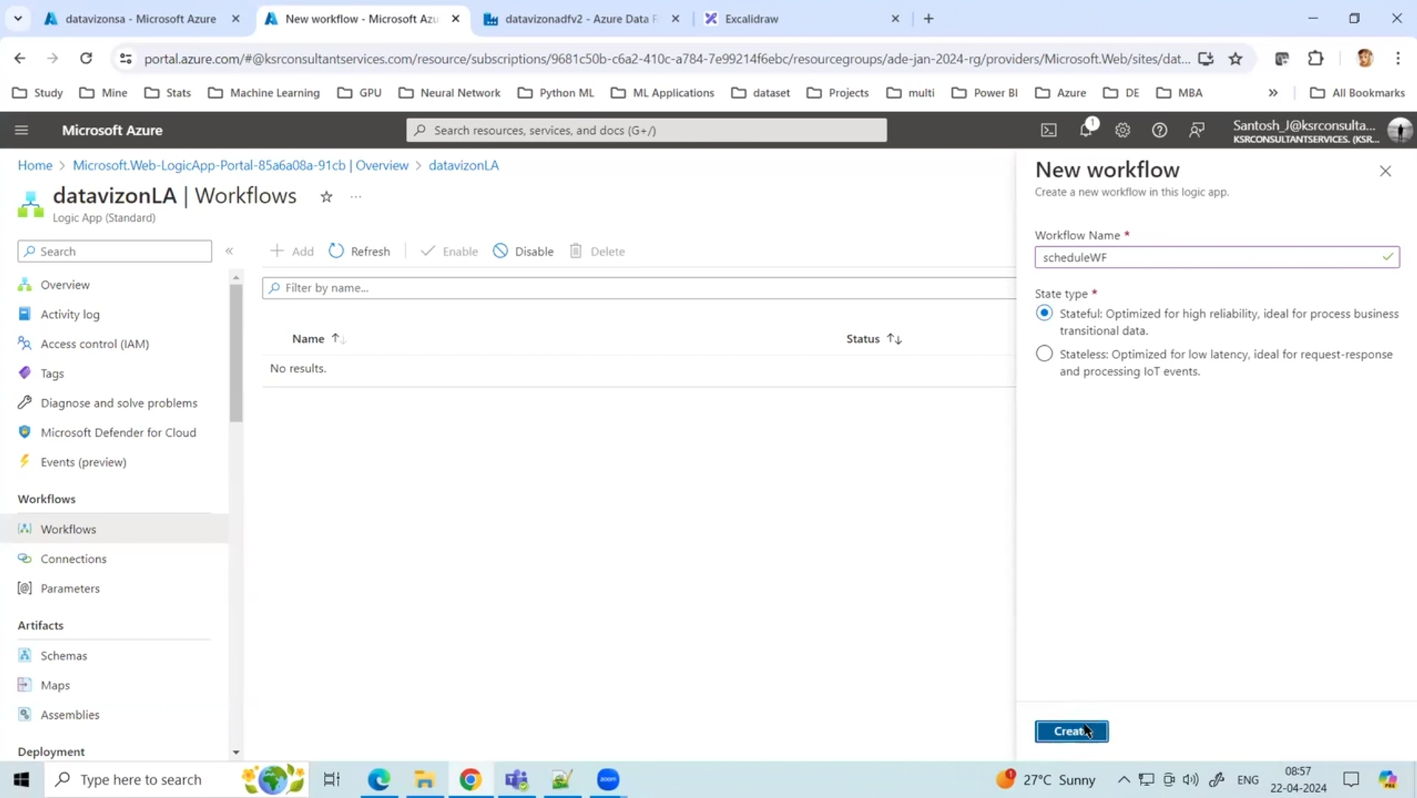
Open Created Workflow and Select Designer

Slide 6
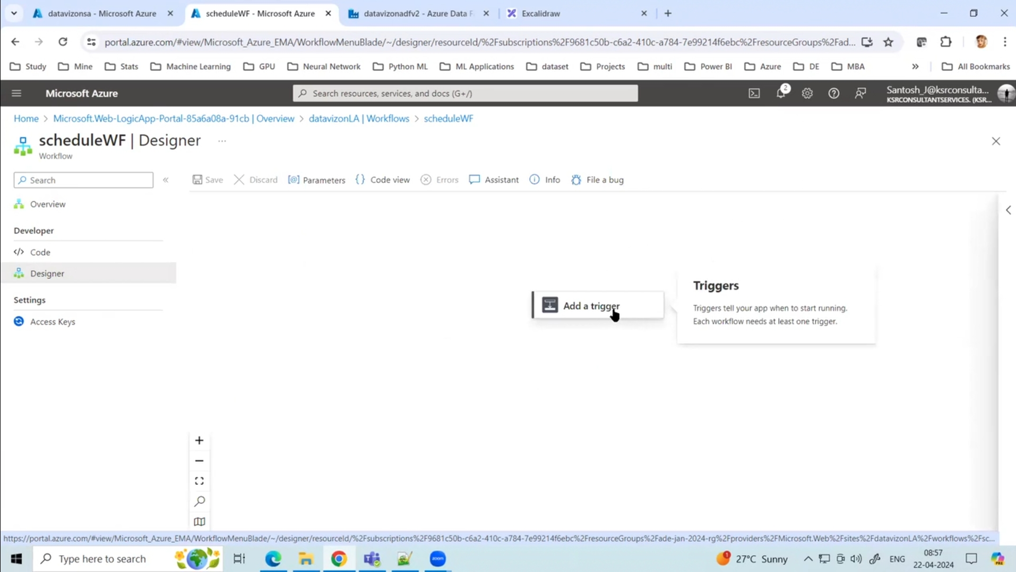
Add a Trigger

Slide 7
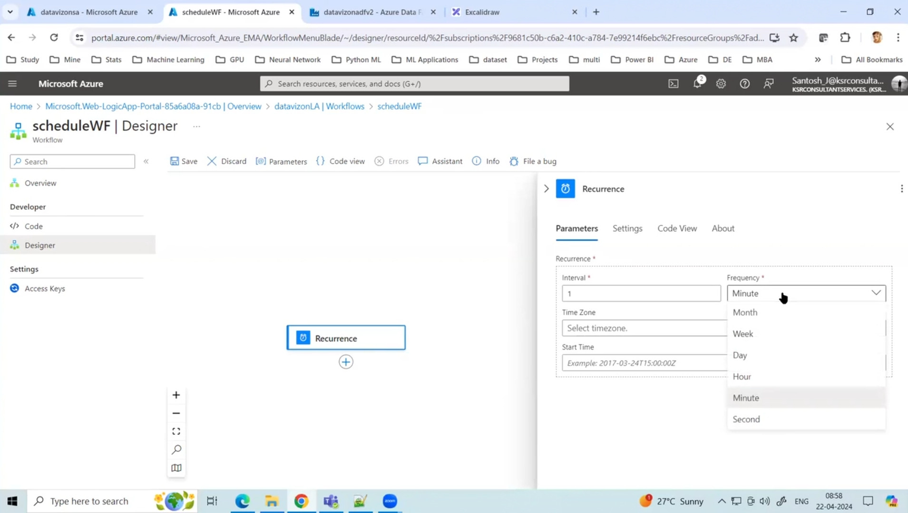
Search Recurrence and open it

Slide 8
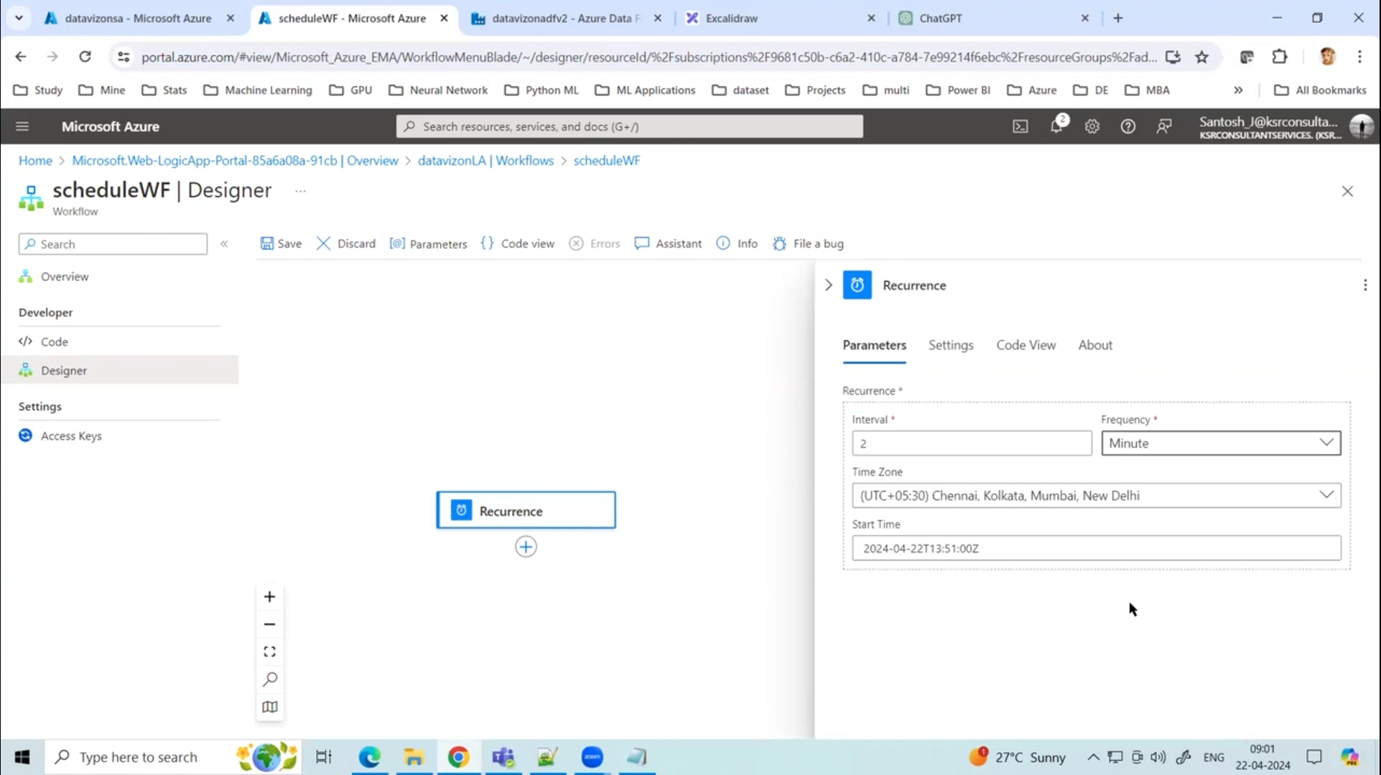
In Recurrence, we can repeat pipeline run at any minute, hour, week, second, day, month.

Slide 9
Here, we will run pipeline for every 2 minute

Slide 10
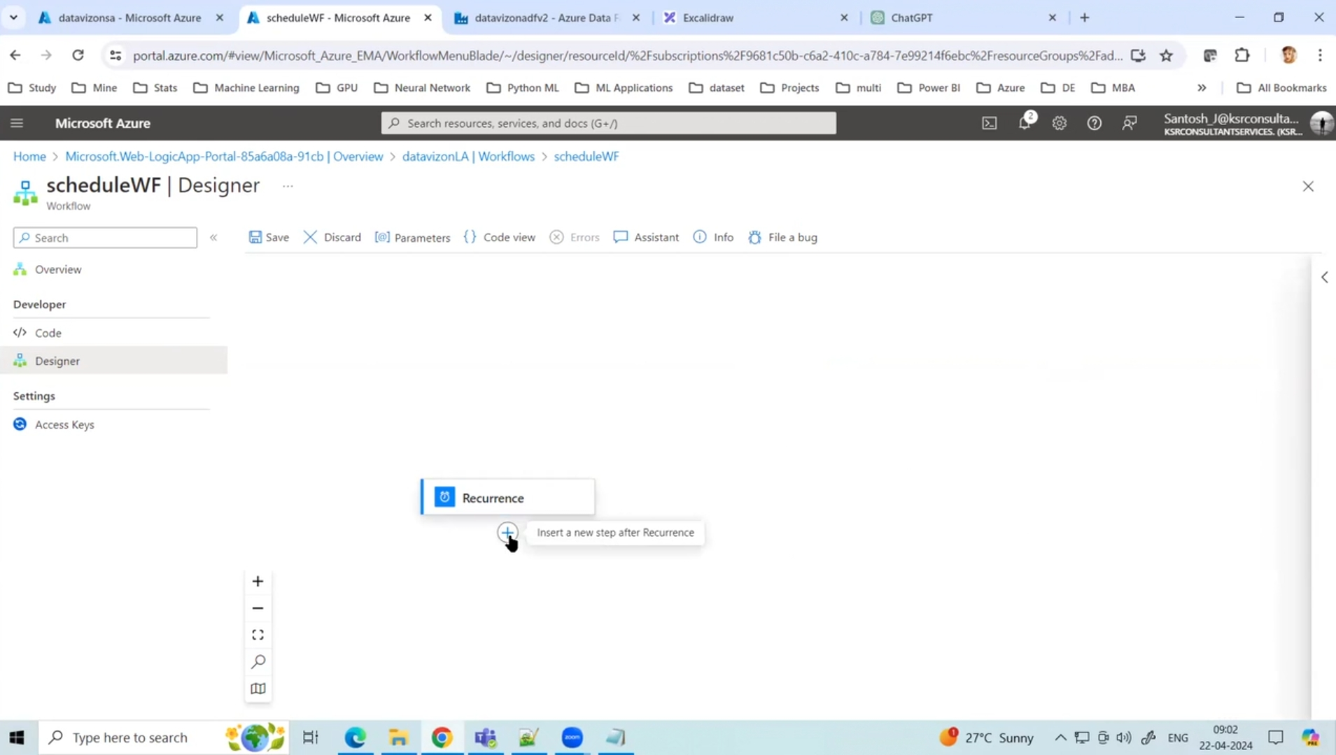
Add Action

Slide 11
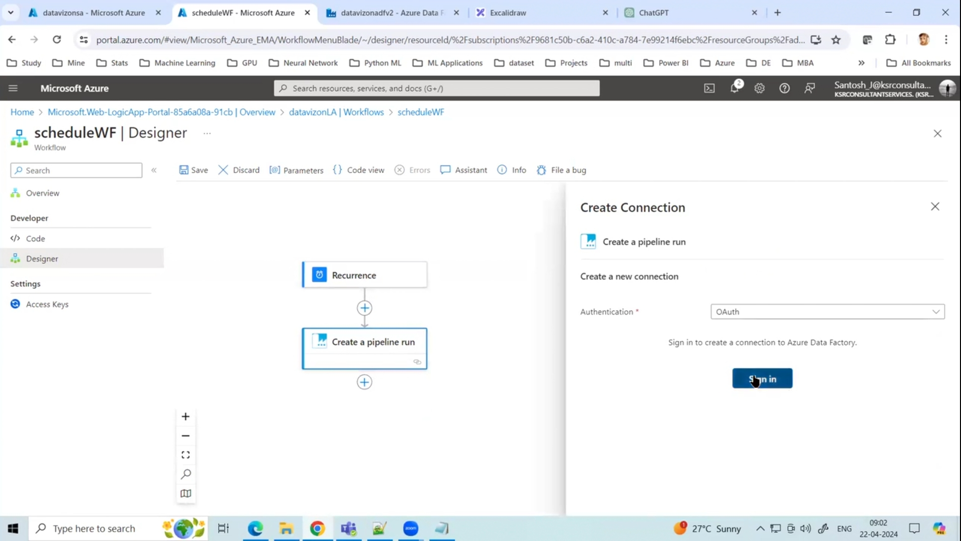
Click on Azure data factory > Create a Pipeline run ( This means foor every 1 min pipeline will be run)

Slide 12
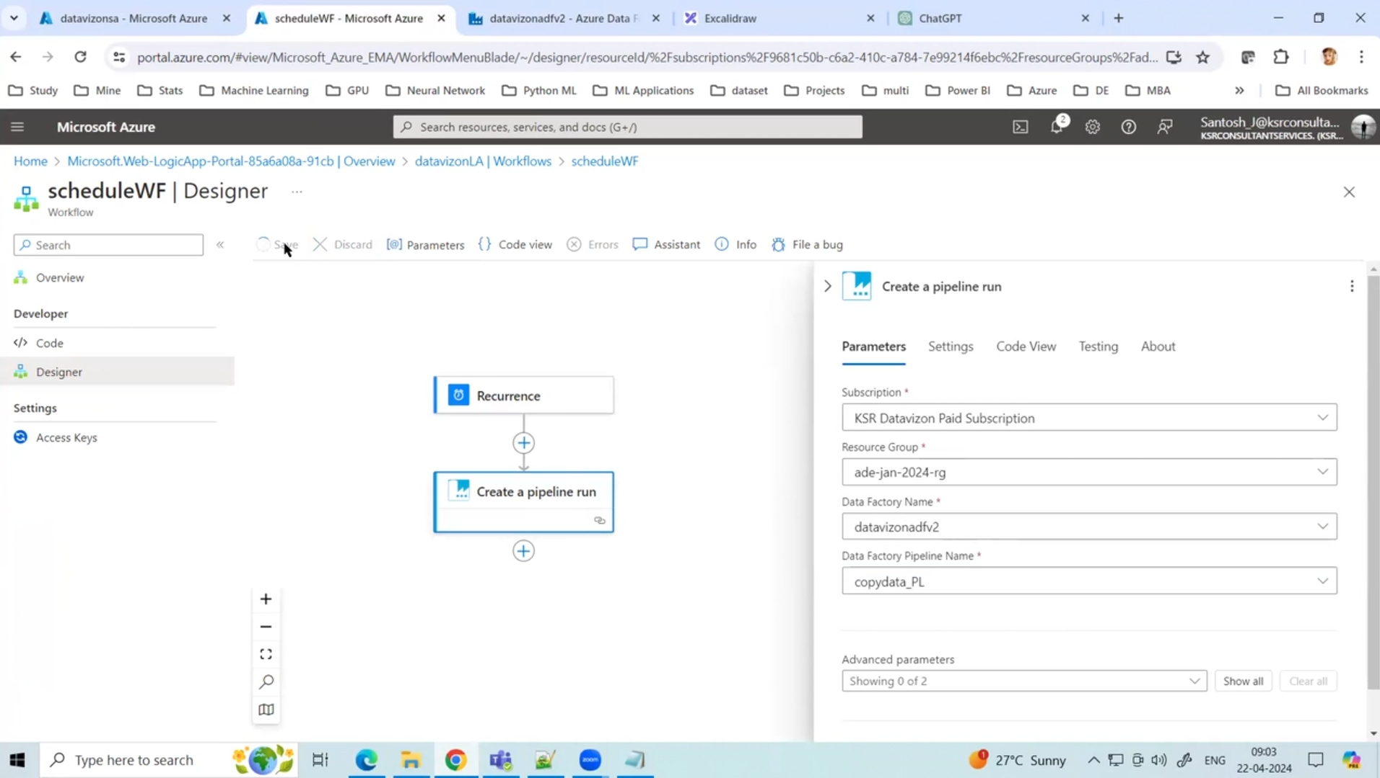
Sign in with ‘Create a Pipeline run’ with Ms Account

Slide 13
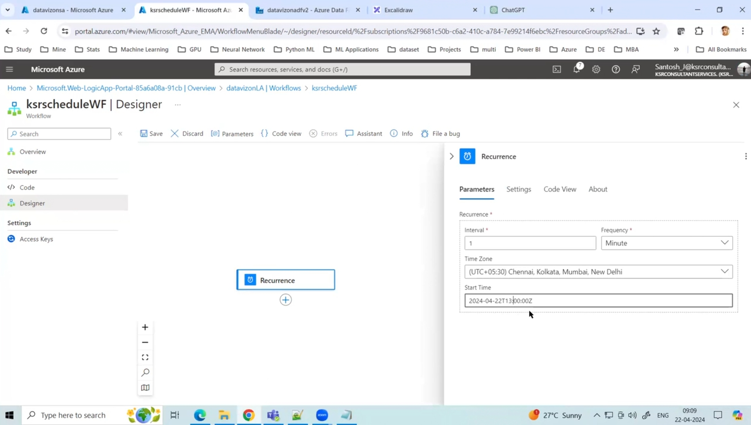
Fill all the parameters and save it

Slide 14
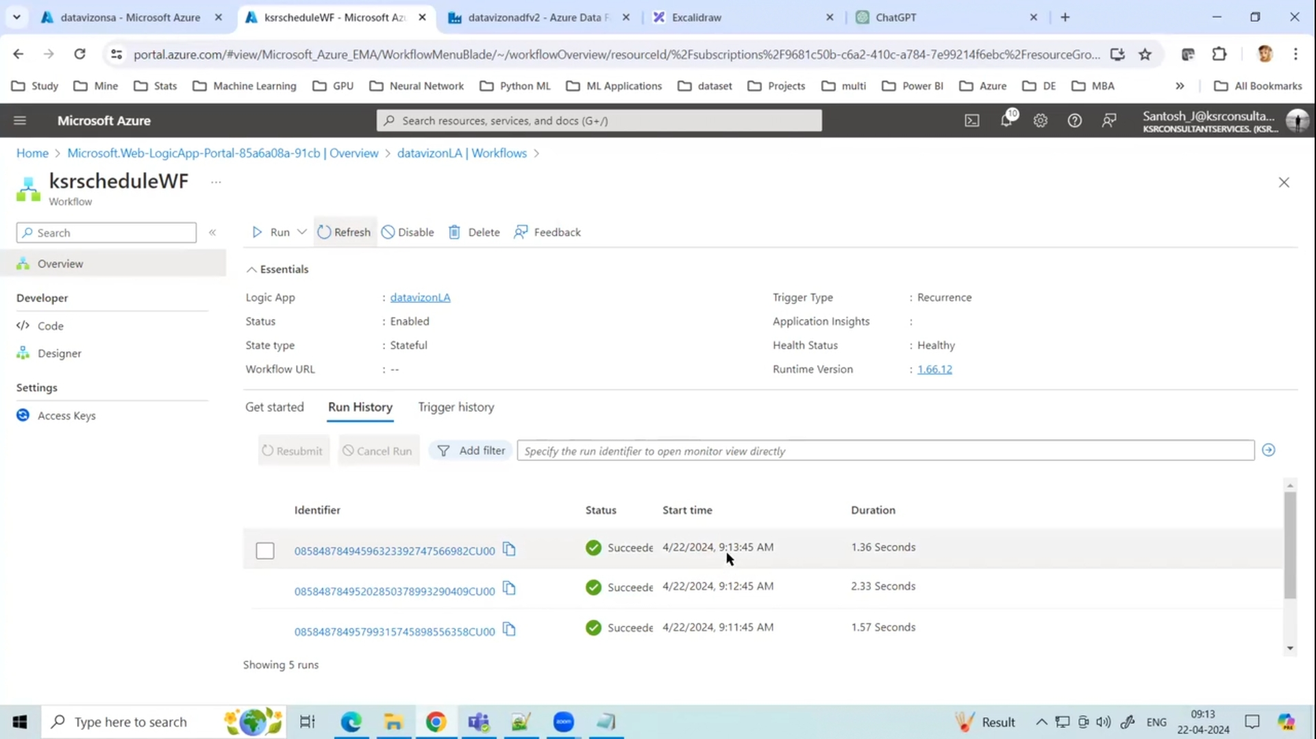
Now just run and go to run history and Trigger History to see whether it is working or not

Slide 15
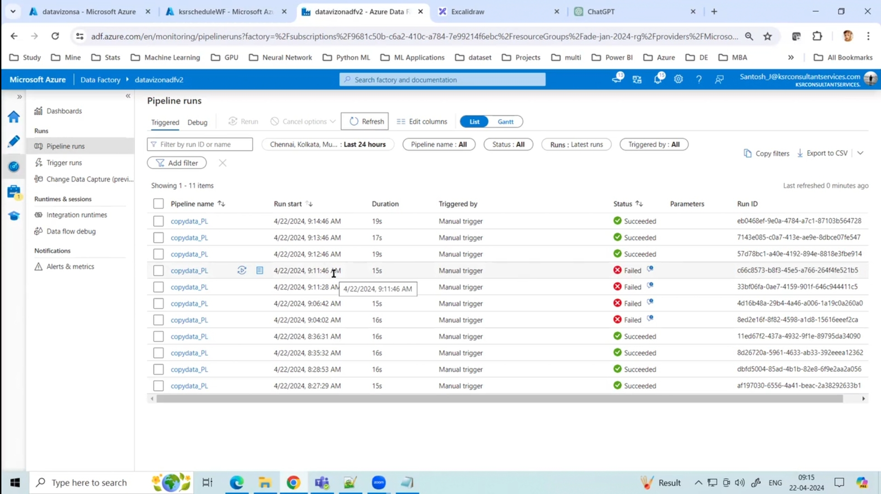
Now check in ADF whether pipeline are successful on automation or not ( Now in this, it will show manual trigger as it is trigger by other service and not ADF schedule trigger {ADF also has it own Scheduler})

